Slide 1
RE-FORESTATION USING ROBOTIC VEHICLE
PIP2001 Capstone Project
Review-4
Batch Number: CIT-G15
STUDENT NAME | ROLL NUMBER
20211CIT0070 | NANDINI R
20211CIT0101 | REDDY SREYA
20211CIT0106 | CHANDANA K
20211CIT0153 | VINUTHA K
Under the Supervision of,
Dr. Anandaraj S P
Head Of Department CCS,CIT
School of Computer Science and Engineering
Presidency University
Name of the Program: CSE IOT
Name of the HOD: Dr. Anandaraj S P
Name of the Program Project Coordinator: Dr. Sharmasth Vali Y
Name of the School Project Coordinators: Dr. Sampath A K / Dr. Abdul Khadar A / Mr. Md Ziaur Rahman

Slide 2
INTRODUCTION
The next step toward more advanced agricultural practices is an automatic agriculture robot car, especially in a country like India, where agriculture forms the backbone of the economy and contributes highly to GDP. This innovative research introduces a novel approach for reforestation by integrating robotic vehicles with cutting-edge software and hardware components that can be used to improve productivity and sustainability in reforestation practices. The overall purpose of this study is to harness more advanced technologies like robotic vehicles and machine learning algorithms in farming and reforestation processes for the betterment of these operations. This system is proposed with two functionalities. The first is the robotic vehicle, which would automatically perform all farm operations such as ploughing, sowing, and irrigation, so planting is more precise and more resources are efficiently utilized. The second is a crop prediction system based on sensor readings from temperature, soil moisture, and atmospheric pressure to provide real-time data and suggest which crops will grow best in that area.

Slide 3
INTRODUCTION(Cont..)
The machine learning algorithms trained on the historical field data analyze these inputs to recommend adaptive crops, reducing the chances of crop failure and improving planting accuracy. This approach therefore has several transformative advantages including increased productivity due to decreased labor needs and improved accuracy in operations, sustainability through adaptive cropping and highly precise irrigation, and farmer empowerment, enabling adequate actionable information for beginning farmers. This marks a landmark for modernizing the farming and reforestation practices with the automated agriculture robot car and integrated functionalities. This research is bound to open future possibilities for where technology and agriculture blend to create sustainable solutions for the globe in addressing challenges related to food security and ecological sustainability by combining robotics with data-driven insights.

Slide 4
LITERATURE REVIEW
01) Vision-based Planting Position Selection System for an Unmanned Reforestation Machine - Songyu Li, Morgan Rossander, Hakan Lideskog. 2024.
OBSERVATIONS
The primary aim of the research paper is obstacle detection. The system effectively detects obstacles within specified areas , adequately approximating their positions and sizes for tree-planting operations.
Plantable Region Extraction is one of the objective. The extraction of plantable areas and planning of planting points proved effective, achieving a feasible seedling density of 3400 seedlings/ha under ideal conditions and enabling adaptation to a standard target of 2500 seedlings/ha.
Adjustable Seeding Density is the feature of the developed application. The kernel outer radius can be adjusted in real-time by a controller to adapt seeding density, addressing variations in target densities or field conditions.
3. The system demonstrated success in autonomous reforestation cycles, leveraging a vision-based planting position selection system in forest terrain for the first time.

Slide 5
LITERATURE REVIEW(Cont..)
02) Design And Implementation Of An Urban Farming Robot.
- Michail Moraitis ,Konstantinos Vaiopoulos , Athanasios T.Balafoutis (2022)
OBSERVATIONS
The main objective of image stitching process was achieved after selecting the openCV library.
The plant identification process was evaluated by comparing the robot’s output with a ground truth dataset or expert labels. Accuracy was determined by how correctly the system could classify different plant species or types, considering factors such as environmental conditions and image quality.
High accuracy ensures the system can reliably identify plants in various settings and scenarios.
4. Localization accuracy is measured by determining the deviation between the robot’s predicted position of a plant and its actual position in the environment. This is crucial for ensuring that the robot can accurately navigate and interact with plants, especially in tasks like plant inspection or picking.
5. Errors in localization can lead to misidentification or missed plants, compromising the robot's performance.

Slide 6
LITERATURE REVIEW(Cont..)
03) Machine Learning In Applied Fruit Trees Yield Foretelling As Per Field Data And Satellite Imaging : A Case In Citrus Orchard- Abdellatif Moussaid, Sanaa El Fkihi, October (2022).
OBSERVATIONS
The final model, combining field data and spectral information, achieved very satisfactory results with an average error of no more than 0.162.
The approach was cost-effective, using easily collectable field data and free satellite images, making it a practical solution for farmers to gain reliable yield predictions before harvest.
Field data, such as irrigation, fertilization, and phytosanitary treatments, has shown to significantly improve yield prediction models. Combining these data with spectral information from satellite or UAV images creates a more cost-effective and efficient way to predict tree yield, especially in large-scale operations.
While spectral data (e.g., vegetation indices from satellite images) was important for estimating tree yield, it often relies on high-cost, paid satellite images, which are not accessible to all farmers. The integration of field data can help offset the cost and improve the prediction accuracy, making the process more affordable for smaller-scale farms.

Slide 7
LITERATURE REVIEW(Cont..)
04) Planting Module Design for Automating Afforestation Tylek Pamwek, Szewczyk Grzegorz (2023)
OBSERVATIONS
The paper highlights the labor-intensive nature of manual forest regeneration, which requires significant time and effort (38 man-hours/ha for manual planting). This serves as the primary motivation for developing an automated system to reduce human labor and increase efficiency in forest planting.
The proposed autonomous robot aims to revolutionize forest regeneration by automating the planting process. This is achieved through an innovative technology that includes a key working unit: a universal, openable dibble combined with a three-toothed shaft, which prepares the soil for planting without the need to stop the base vehicle, ensuring continuous operation.
The introduction of the autonomous robot for forest regeneration promises to significantly reduce the time required for planting by replacing manual labor, leading to more efficient use of resources. Additionally, the continuous operation feature of the machine reduces downtime, potentially improving the cost-effectiveness of afforestation efforts.

Slide 8
LITERATURE REVIEW(Cont..)
05) Application of Artificial Intelligence Technology Into Smart Farm Robot Operations
- Joy Iong-Zong Chen and Pisith Hengjinda
OBSERVATIONS
The camera in the sensor control subsystem enables the robot to capture images and compare them to monitor the growth of rice plants.
By analyzing these images, the robot can accurately detect any diseases that may affect the rice plants, ensuring early intervention and better crop management.
The ultrasonic sensor measures the water level in the rice field. If the water level falls below a preset threshold, the robot can trigger the main station to pump water back into the paddy at a consistent rate, ensuring the rice plants receive the proper amount of water for optimal growth.
4. The temperature and humidity sensor helps the robot monitor the environmental conditions of the rice field. When the air temperature rises above a set threshold, the robot can instruct the main station to spray water into the air to lower the temperature, providing a more favorable environment for plant growth.

Slide 9
RESEARCH GAPS
Limitations in Current Technological Advancements in Agriculture: These challenges emphasize the need for further innovation and refinement to address the diverse and complex demands of modern farming practices
Urban Garden Focus and Scalability Issues :Transitioning these systems to rural settings requires substantial modifications to handle uneven terrains, unpredictable weather, and diverse crop requirements.
Inadequate Integration of Advanced Analysis Techniques : Accurate crop predictions and recommendations require synthesizing diverse datasets, including soil composition, weather forecasts, pest patterns, and historical trends.
Absence of Real-Time Data Integration : Many current technologies fall short in incorporating real-time monitoring capabilities. Parameters such as soil moisture, temperature, humidity, and atmospheric pressure need continuous observation to inform decisions on irrigation, fertilization, and pest management.
Limitations in Sensor-Based Monitoring : Fragmented approach restricts the ability of systems to account for the complex interactions between various environmental factors that influence crop health.
Over-Reliance on Historical Data : The dependence on historical data is another critical shortfall in current agricultural technologies. Historical datasets are invaluable for understanding trends, such as seasonal crop yields or pest behaviours.
Path Forward : To overcome the limitations currently hindering the effectiveness and adoption of advanced agricultural technologies, future developments should focus on creating more integrated, adaptable, and data-driven systems.

Slide 10
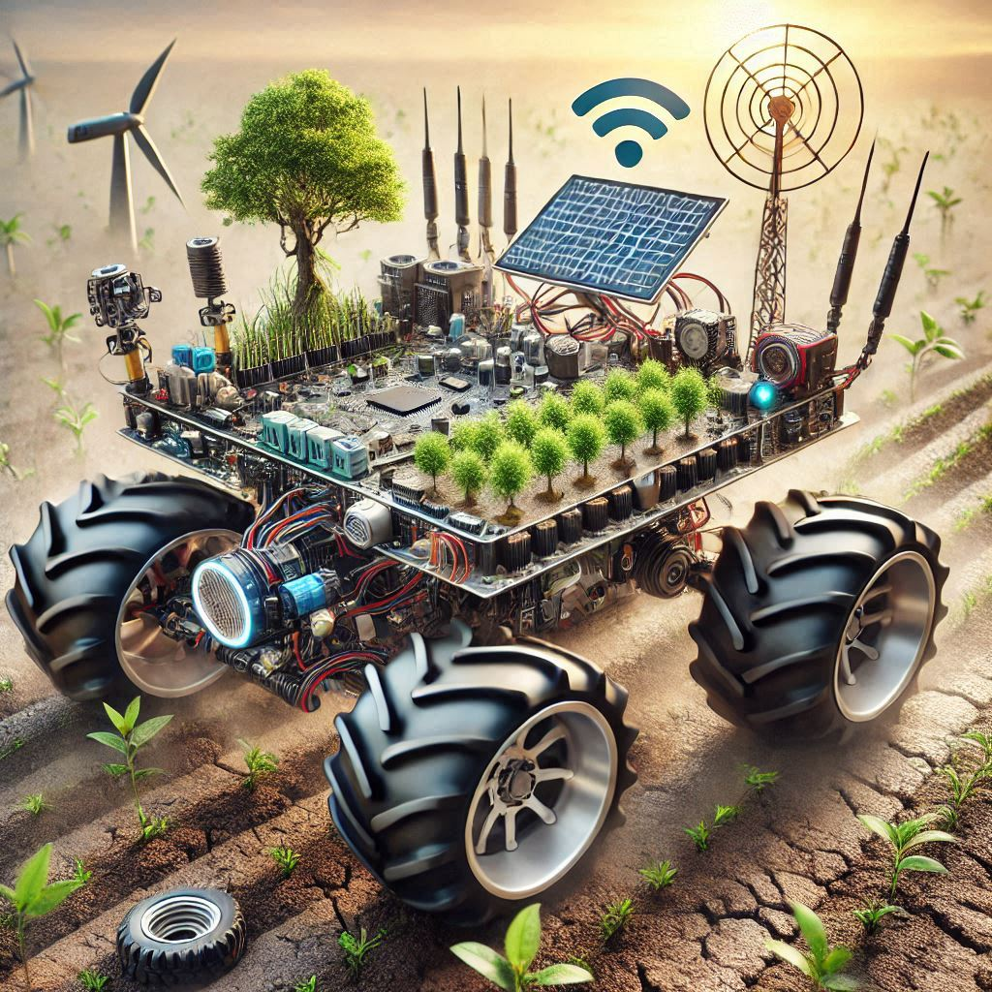
PROPOSED METHODOLOGY
1.Reforestation Robotic Vehicle:
The Hardware Backbone
2.Data Management and Remote
Control via Blynk App
3.Sensor Integration for Real-Time
Environmental Monitoring
4.Precision in Planting and Maintenance

Slide 11
OBJECTIVES
Design and develop a robust and cost-effective robotic vehicle equipped with necessary sensors such as GPS, LiDAR, cameras, etc., actuators, and control systems for autonomous navigation and operation in diverse field conditions.
Develop and implement autonomous systems for pest and disease control, such as targeted spraying or the release of beneficial insects.
A decision support system: be developed so that farmers may receive in-time and also accurate irrigation, fertilizers, and pest control inputs based on crop predictions coupled with the environmental conditions.
Collect data and analyze data gathered from the field test and pinpoint where changes are necessary for refining system design and operations.
User-friendly interfaces and training programs have to be developed to assist farmers in adopting and appropriately using the technology.

Slide 12
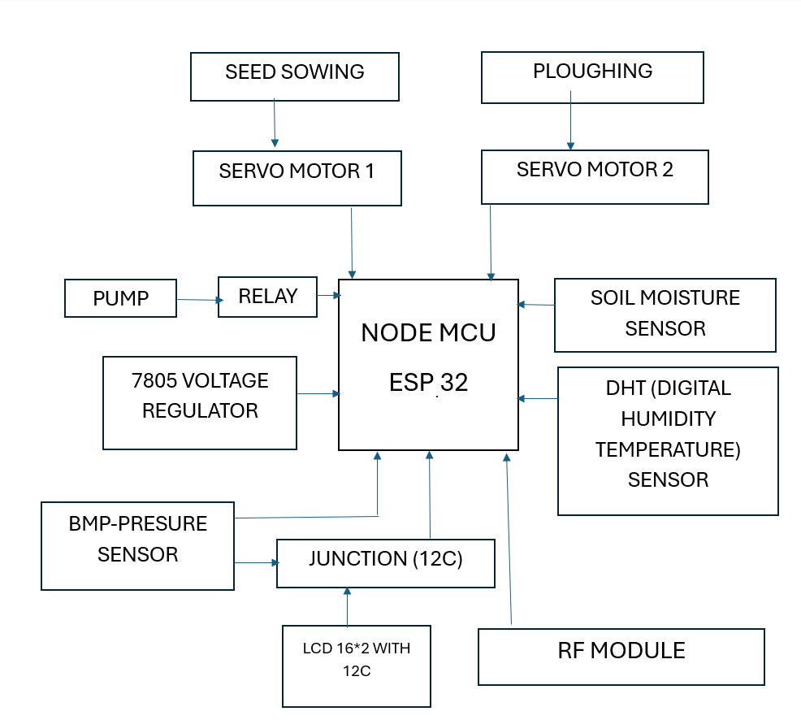
SYSTEM DESIGN AND IMPLEMENTATION

Slide 13
SYSTEM DESIGN AND IMPLEMENTATION
Step 1: Hardware Setup
1.1 Node MCU ESP32 Integration
1.2 Sensors Setup
1.3 Actuators Setup
1.4 LCD Display (16x2 with I2C)
1.5 RF Module
Step 2: Programming
2.1 Setting Up the Environment
2.2 Code Development
Step 3: Power Supply Management
Step 4: Testing and Debugging
Step 4: Testing and Debugging
4.1 Individual Component Testing
4.2 Integration Testing

Slide 14
SYSTEM DESIGN AND IMPLEMENTATION
Step 5: Deployment
5.1 Installation
5.2 Monitoring and Maintenance
Key Functionalities
Automated Irrigation:
If the soil moisture is low, the pump will activate to irrigate the field.
Ploughing and Seed Sowing:
Servo motors perform ploughing and controlled seed sowing operations.
Weather Monitoring:
The DHT and BMP sensors provide environmental data for better decision-making

Slide 15
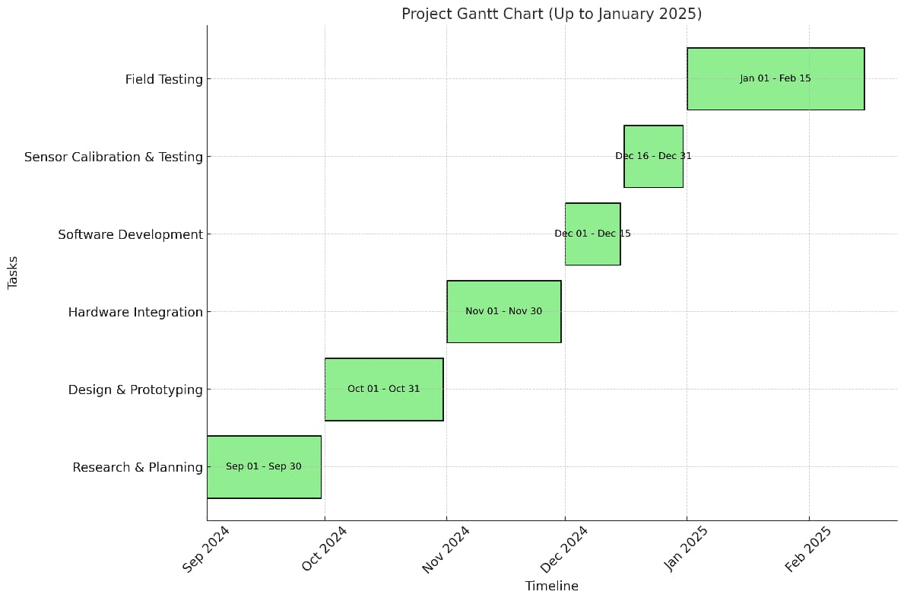
TIMELINE FOR EXECUTION OF PROJECT

Slide 16
TIMELINE FOR EXECUTION OF PROJECT
Project Timeline:
1. Research & Planning
Start Date: September 1, 2024 - End Date: September 30, 2024
Duration: 1 month - Dependencies: None
Description: This phase involves initial research and planning activities to set the groundwork for the project. It includes defining objectives, identifying requirements, and creating a project plan.
2. Design & Prototyping
Start Date: October 1, 2024 - End Date: October 31, 2024
Duration: 1 month - Dependencies: Research
Description: In this phase, the design and prototyping of the robotic vehicle take place. This includes creating detailed designs, building prototypes, and testing initial concepts.

Slide 17
TIMELINE FOR EXECUTION OF PROJECT(Cont..)
3. Hardware Integration
Start Date: November 1, 2024 - End Date: November 30, 2024
Duration: 1 month - Dependencies: Design
Description: This phase involves integrating various hardware components into the robotic vehicle. This includes assembling sensors, actuators, and control systems to ensure they work together seamlessly.
4. Software Development
Start Date: December 1, 2024 - End Date: December 15, 2024
Duration: 0.5 month - Dependencies: Design
Description: During this phase, the necessary software for controlling the robotic vehicle is developed. This includes programming control algorithms and creating user interfaces.

Slide 18
TIMELINE FOR EXECUTION OF PROJECT(Cont..)
5. Sensor Calibration & Testing
Start Date: December 16, 2024 - End Date: December 31, 2024
Duration: 0.5 month - Dependencies: Hardware
Description: This phase involves calibrating the sensors and testing the entire system to ensure it operates correctly. Any necessary adjustments are made to optimize performance.

Slide 19
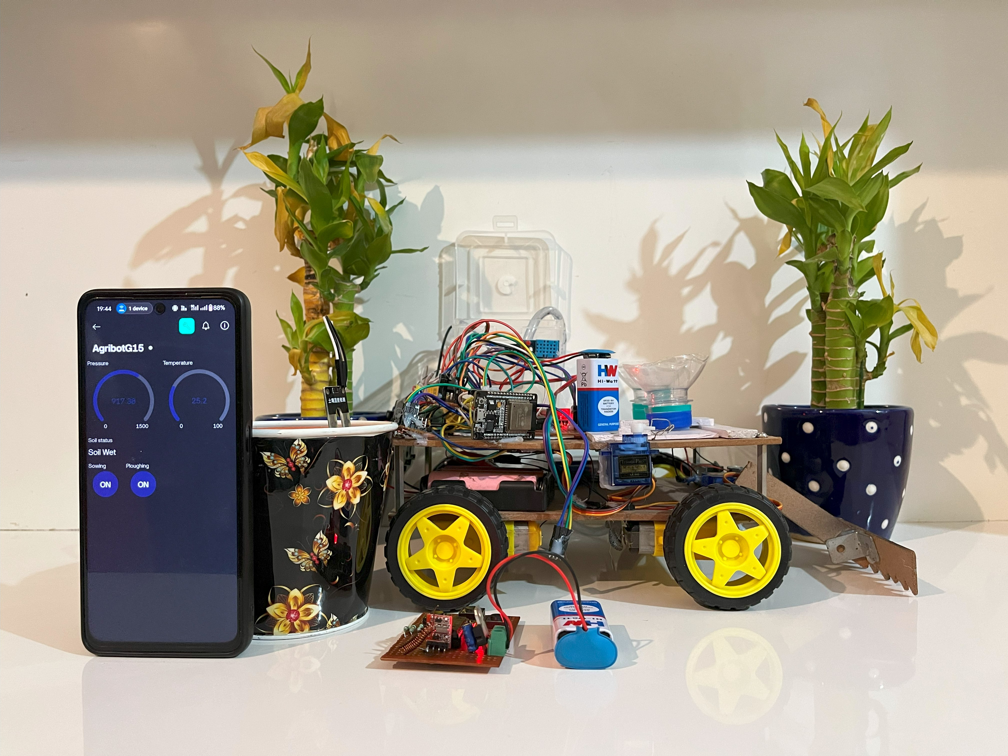
OUTCOMES
Better productivity and Sustainability
Powerful Crop Prediction
Guide for novice Farmers
Automatic Farming Practices
Successful checking out on Rice
and Wheat plants
Insights for destiny traits
Ecological and monetary advantages

Slide 20
CONCLUSION
The system automated critical agricultural tasks like ploughing, seed sowing, and irrigation, enhancing precision and reducing reliance on manual labor. This was achieved by integrating the Node MCU ESP32 microcontroller, sensors, and servo motors into a cost-effective and energy-efficient solution. The ESP32, with its dual-core processing and Wi-Fi connectivity, served as the system's hub, efficiently managing tasks like sensor data processing, motor control, and communication. Its scalability and affordability made the solution accessible to a wide user base.
Real-time data from sensors, including soil moisture, temperature, and atmospheric pressure, optimized resource usage. For example, the irrigation system activated only when soil moisture dropped below a set threshold, conserving water. Servo motors ensured precision in ploughing and seed sowing, achieving uniformity in seed placement and soil preparation while maintaining energy efficiency.
RF-controlled mobility added flexibility, allowing the robot to navigate varied terrains and adapt to different conditions. This feature, combined with reliable RF communication, made the system effective for both rural farming and reforestation projects where precision and accessibility are critical.
The system also included a crop and yield recommendation module powered by machine learning algorithms. It analyzed environmental data to suggest suitable crops, improving decision-making and reducing crop failure risks. Yield prediction provided reliable forecasts for better planning and resource allocation.
This smart farming solution combines automation, precision, and real-time data analytics, addressing agricultural challenges while being adaptable, affordable, and energy-efficient. Its scalability makes it ideal for applications ranging from small farms to large-scale reforestation, promoting sustainable and advanced farming practices.

Slide 21
REFERENCES
[1] F. a. A. O. (FAO), "The State of Food and Agriculture 2020: Overcoming Water Challenges in Agriculture".
[2] P. S. a. N. G. R. Singh, "Emerging Technologies in Agriculture," Journal of Agricultural Sciences, vol. 27, p. 5, 2019.
[3] J. W. a. Q. L. Y. Zhang, "Application of Robotics in Agriculture: Challenges and Opportunities,” International Robotics Journal, vol. 18, pp. 105- 121, 2021.
[4] K. V. a. A. T. B. M. Moraitis, "Design and Implementation of an Urban Farming Robot,” Agricultural Robotics Quarterly, vol. 5, pp. 45-58, 2022.
[5] J. I. Z. C. a. P. Hengjinda, "Applying AI Technology to the Operation of Smart Farm Robot,” Artificial Intelligence in Agriculture, vol. 4, pp. 12- 25, 2019.
[6] S. L. a. H. L. M. Rossander, "Vision-Based Planting Position Selection System for an Unmanned Reforestation Robot," Forestry Robotics Journal, vol. 12, pp. 33-45, 2024.
[7] M. S. a. P. Gupta, "Automation and IoT: Bridging technology and agriculture," Computers and Electronics in Agriculture, pp. 102-112, 2020.
[8] A. M. a. S. E. Fkihi, "Machine Learning Applied to Tree Crop Yield Prediction Using Field Data and Satellite Imagery: A Case Study in a Citrus

Slide 22
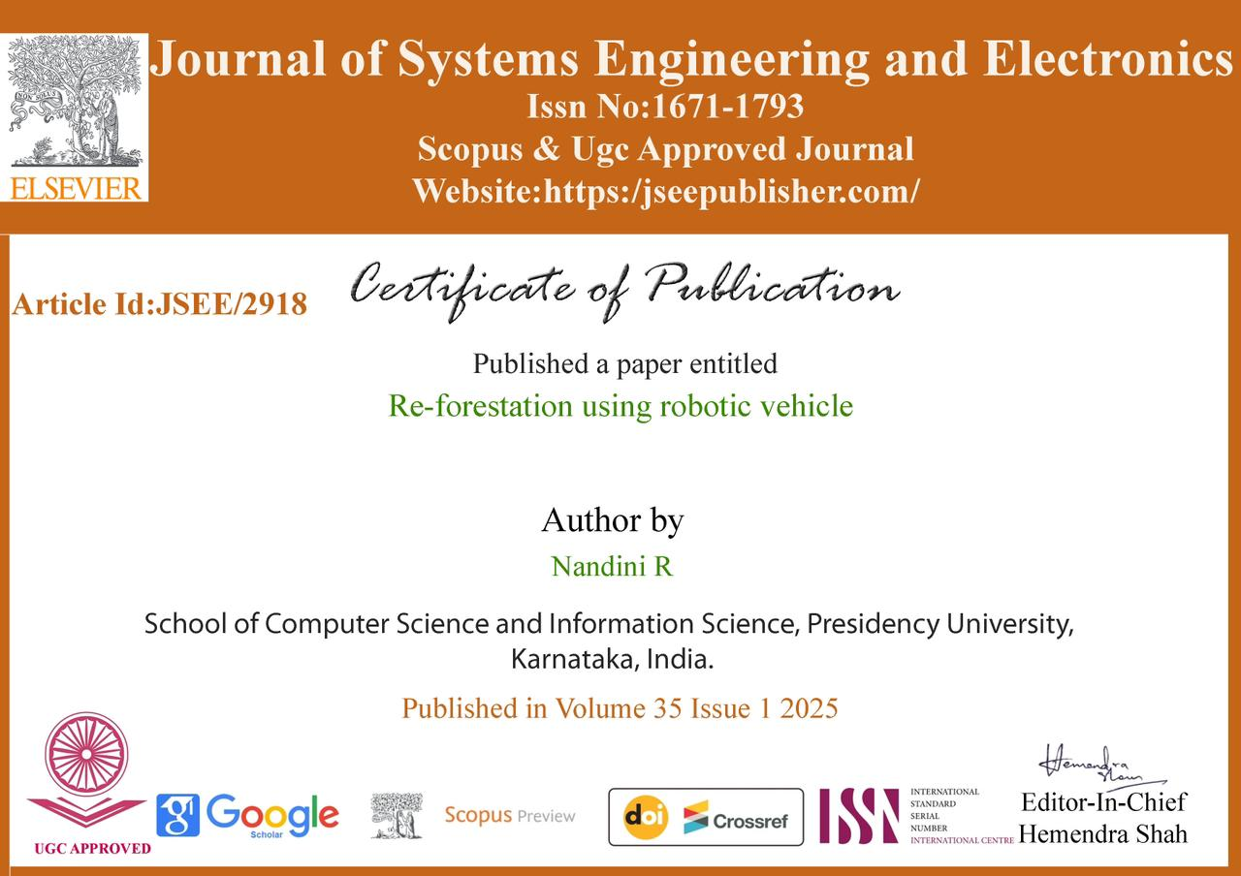
PUBLICATIONS

Slide 23


Slide 24


Slide 25


Slide 26


Slide 27
THANK YOU !!!!

